Slide 1

COSI 104a Introduction to machine learning
Chapter 11 – Ensemble Learning
 | Instructor: Dr. Hongfu Liu Email: hongfuliu@brandeis.edu

Slide 2
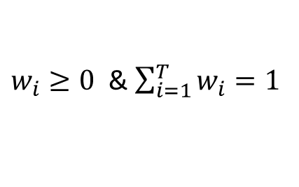
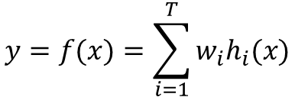
Introduction
Ensemble learning methods combine multiple learning models to achieve better predictive performance than any of the constituents alone
$$y=f(x)=\sum_{i=1}^{T}{w_{i}h_{i}(x)}$$
Quiz
For example
$w_{i}≥0$ & $\sum_{i=1}^{T}{w_{i}}=1$
Commonly used ensemble methods
Bootstrap aggregating (Bagging)
Boosting
Bayesian Averaging
…

Slide 3
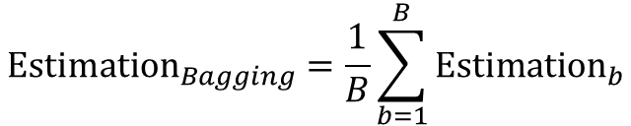
Bagging – Bootstrap Aggregating
Training dataset D = {<x_{i}, y_{i}>}_{i=1,…,50}
Sampling
…
Bootstrap datasets
D₁
D₂
…
D_{B}
Base learners
…
Estimation 1
Estimation 2
Estimation B
$$Estimation_{Bagging}=\frac{1}{B}\sum_{b=1}^{B}{Estimation_{b}}$$

Slide 4
Bagging
The estimator can be significantly improved if the learning algorithm is unstable.
Unstable: small changes to the training data causes large changes in the output hypothesis
Reduce the error.
Assume the errors from bootstrap have zeros mean and are uncorrelated, the average error of a model can be reduced by a factor of B.

Slide 5
Random Forest
Training dataset D = {<x_{i}, y_{i}>}_{i=1,…,50}
Sampling
…
Bootstrap datasets
D₁
D₂
…
D_{B}
…
Tree learners
Tree 1
Tree 2
Tree B
Each node split only considers a random subset of features
Classification: majority voting
Regression: average

Slide 6
Basic Idea of Boosting
Existence of weak learners (base learners): A weak learner is a “rough and moderately inaccurate” predictor, but one that can predict better than chance.
Combine base learners

Slide 7


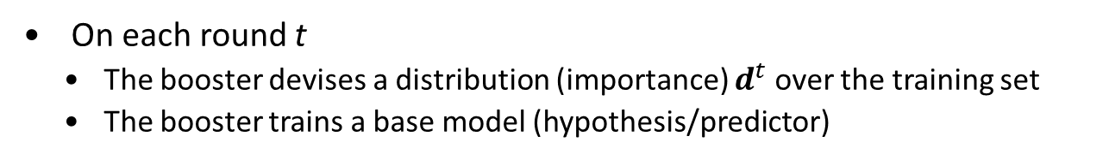

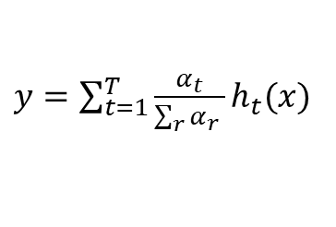







Boosting Procedure
Given a set of labeled training set $S=\{\left\langle x_{i},y_{i}\right\rangle \}$
On each round t
The booster devises a distribution (importance) $d^{t}$ over the training set
The booster trains a base model (hypothesis/predictor)
Combine the weak hypotheses into a single prediction rule.
$$d^{1}$$
$$d^{2}$$
$$d^{3}$$
…
$$d^{T}$$
BaseLearner ($S,d^{1}$)
BaseLearner ($S,d^{2}$)
BaseLearner ($S,d^{T}$)
$$α_{1}h_{1}(x)$$
$$α_{2}h_{2}(x)$$
$$α_{T}h_{T}(x)$$
⊕
$y=\sum_{t=1}^{T}{\frac{α_{t}}{\sum_{r}{α_{r}} }h_{t}(x)}$

Slide 8
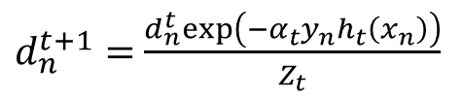
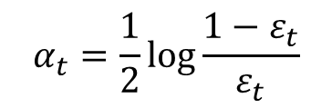
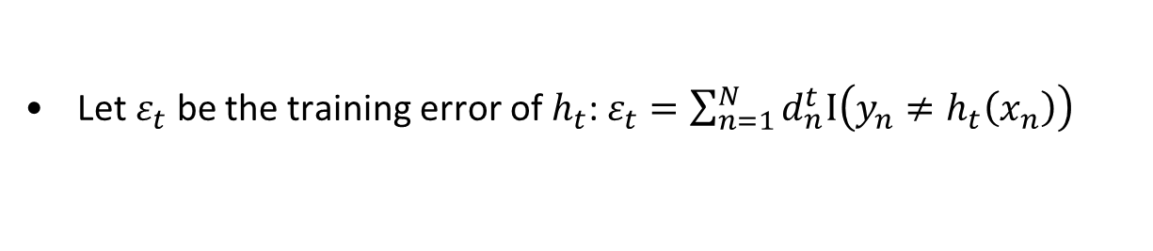

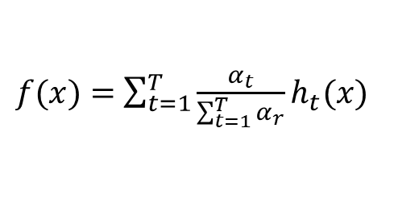
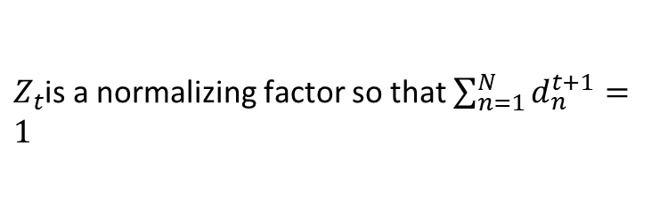
AdaBoost
Given a training set $S={\left\{\left\langle x_{i},y_{i}\right\rangle \right\}}_{i=1,…,N}$, where $y_{i}=±1$
Initialize $d^{1}={\left\{d_{i}^{1}=\frac{1}{N}\right\}}_{i=1,…,N}$
for $t=1$ to T
Using $S$ and $d^{t}$, train a base learner $h_{t}:x→y$.
Let $ε_{t}$ be the training error of $h_{t}$: $ε_{t}=\sum_{n=1}^{N}{d_{n}^{t}I\left(y_{n}≠h_{t}\left(x_{n}\right)\right)}$
$$α_{t}=\frac{1}{2}\log{\frac{1−ε_{t}}{ε_{t}}}$$
Set the weight of the $h_{t}$ as
$d_{n}^{t+1}=$ $\frac{d_{n}^{t}exp\left(−α_{t}y_{n}h_{t}\left(x_{n}\right)\right)}{Z_{t}}$
Update the sample weights
$Z_{t}$is a normalizing factor so that $\sum_{n=1}^{N}{d_{n}^{t+1}}=1$
If ( $ε_{t}=0$ or $ε_{t}>\frac{1}{2}$ ), set $T=t−1$ and Stop
Output
$f(x)=$ $\sum_{t=1}^{T}{\frac{α_{t}}{\sum_{t=1}^{T}{α_{r}}}h_{t}(x)}$

Slide 9
Bagging vs Boosting
Bagging: the construction of complementary base-learners is left to chance and to the unstability of the learning methods
Boosting: actively seek to generate complementary base-learners – training the next base-learner based on the mistakes of the previous learners.

Slide 10
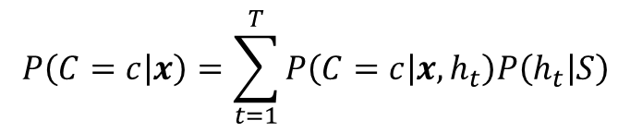
Bayesian Averaging
$$P\left(C=c | x\right)=\sum_{t=1}^{T}{P\left(C=c | {x,h}_{t}\right)P\left(h_{t} | S\right)}$$

Slide 11


